Slide 1
STUDENT GRADE PREDICTION MODEL
STUDENT PERFORMANCE DATASET
GROUP 3
Linus Bälter, Matei Cananau,
Alexander Diez Gonzalez, David Tanudin
Notes:
Welcome to our presentation, we are group number 3 and we have created a student grade prediction model

Slide 2
STUDENT GRADE PREDICTION MODEL
WHAT & WHY WE TRIED
01
Understanding the problem and paving the path to success
HOW WE TRIED
02
They are those where the numerator is greater than the denominator
HOW IT WENT
03
They are those composed of a whole part and a fraction that continues
CONCLUSION
04
Numerator and denominator are multiplied by the same number
Notes:
Our plan is to have a discussion about what and why we tried creating an accurate model, how we tried it, how it went as well as having a small conclusion at the end.

Slide 3
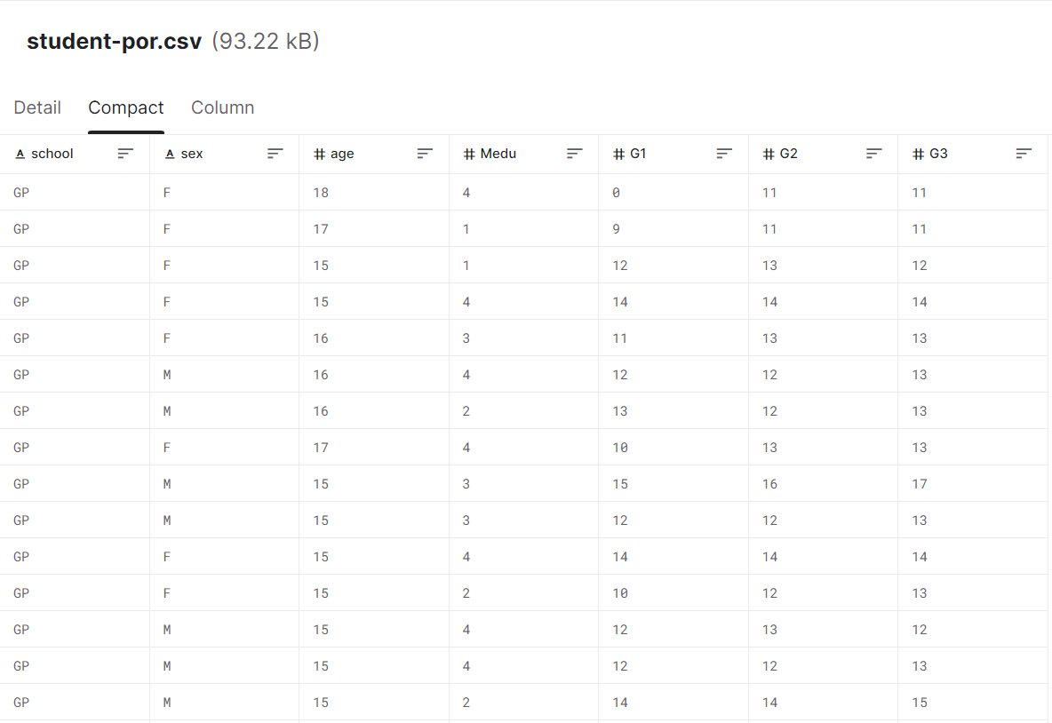
THE DATASET
Notes:
Here is the dataset that we used - note that it’s the same as an earlier group presented. It includes hundreds of students’ demographics, such as their schools, sex, age as well as Mother’s education. It also includes grades from first, second and third period respectively.

Slide 4
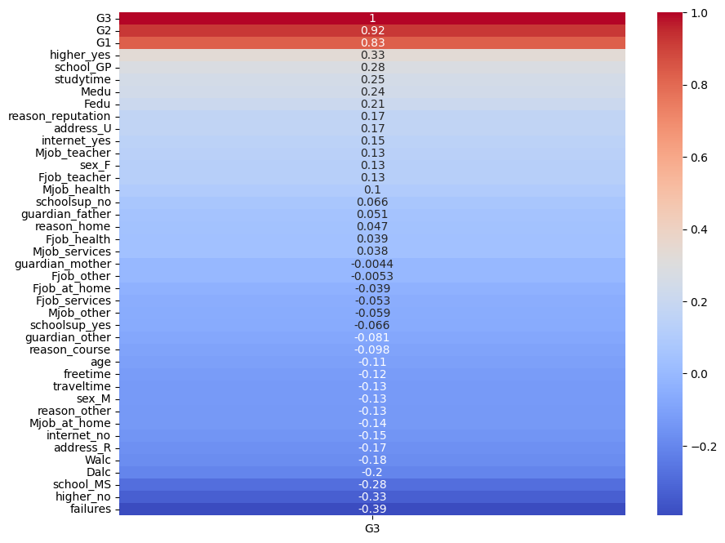
WHAT TO DO
EVALUATION
GOAL | Predicting grades | PREDICT G3
PREDICT | Most important features | TOP AND BOTTOM 3
THEORY | Model without G1, G2 | SKITSNACK
HEATMAP [G3]
Mercury is the closest planet to the Sun and the smallest one in the entire Solar System. This planet's name has nothing to do with the liquid metal, since Mercury was named after the Roman messenger god. Despite being closer to the Sun, Venus is hotter than Mercury
Notes:
Because we want to predict the student’s grade, G3 is the value we should be evaluating. How do we do this - well, we take a look at the most important features. On the right, we can see a heatmap of the highest positive and negative correlations among G3 and all the other values in the dataset. We can pick the top and bottom 3 features and create a balanced model from that data. Now, we had this theory - can we predict G3 without taking G1 and G2 into consideration? That is, can we predict the student’s future grade only by demographics? And the answer is no - unless we want to appear on next year’s Skitsnack presentation due to the low estimation score. The correlation between G1, G2 and G3 is too large to not consider, and the rest too small - you cannot accurately evaluate a student’s grade based only on demographics

Slide 5
PREDICTING G3
G1
GRADES G1
Correlation [G3]: 80%
int: [0:20]
G2
GRADES G2
G3
Correlation [G3]: 90%
int: [0:20]
MISC
DEMOGRAPHICS
Correlation [G3]: [-36:22]%
Sex, age, parent education, etc.
Notes:
Using the heatmap, we logically concluded that, in order to predict G3, we would need to take G1 and G2 into account. This however, does not mean that we should only select those features, as it might lead to overfitting. Therefore, G1, G2 as well as a few other demographic features were used to create the most accurate prediction model

Slide 6
HOW DID WE DO IT?
Regression:
Support Vector Machines
Linear
Decision Tree
Classification:
Naive Bayes
Supervised machine learning application
Clustering:
Kmeans
Matrix factorization:
NMF
Unsupervised machine learning application
01
02
Feature selection:
SelectKBest, chi2
Dim. Reduction:
NMF
Feature selection
/Dim. Reduction
MSE and MAE
Accuracy
03
Evaluation
04
Notes:
SelectKbest, chi2
(feature selection, supervised)
NMF
(Dimensionality reduction, unsupervised)

Slide 7
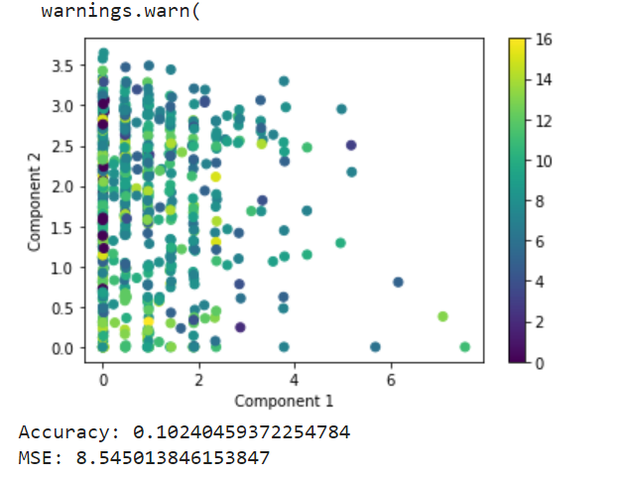
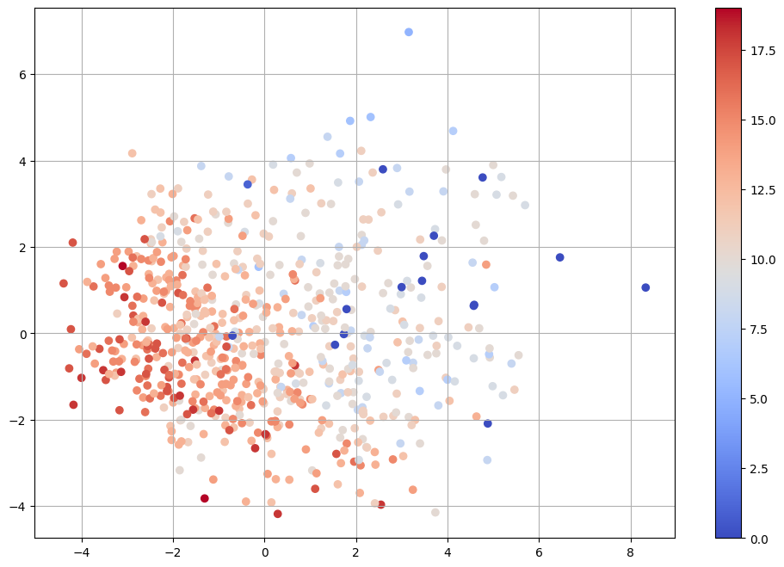
HOW IT WENT - extremely varying results
SUPERVISED
UNSUPERVISED
LASSO, SVM, NB
K-MEANS, NMF
83%
84%
Accuracy
Accuracy
NO G1 & G2
24%
Accuracy
Notes:
So, after doing all of that we received some extremely varying results and I'll briefly talk you through the things we think is the most interesting to mention.
In supervised machine learning we used 3 models; a regression model named Least Absolute Shrinkage and Selection Operator, LASSO for short, the regression variant of the Support Vector Machine model, SVM for short, and Naive Bayes classifer for the top 10% of students that made 1000 runs. For all 3 models we got an average accuracy of about 83%. And the first two models had an average mean square error of about 0.0531 units.
In unsupervised machine learning we used KMeans clustering, where we let k equal to 10, and our accuracy on the clustering scores turned out to be about 84% with a standard deviation of about 8.41 units. We also tried using the decomposition model named Non-negative Matrix Factorization, NMF for short, but that model gave us poor results of about 10% accuracy with a mean square error of 8.54 units.
Then we ran all these models again but this time we excluded the grades G1 and G2 from the training dataset and as you can see, we got a significantly lower accuracy of about 24% and a mean square error of about 7.09 units.

Slide 8
CONCLUSION & ACKNOWLEDGEMENTS
Low scores without G1 and G2
Varying scores due to small data set?
Unclear reliability of factors in data set
group3.isCompetent = “Maybe?”
Notes:
In conclusion, our regression model and classifier were able to achieve accuracy scores in the mid 80’s but only when including the features G1 and G2. In the case of the classifier, this is still around 7 % pts worse than guessing blindly. Without G1 and G2 the classifier’s average accuracy drops by 18 % pts and the F1-score is more than halved, from 0.68 down to 0.25. The regression model’s accuracy drops even more, from 83% to 24%.
One issue we had with the calculation of the models’ accuracies was that depending on the training and test split, the models sometimes could get a lot lower scores than the median value. With the classifier for example, the accuracy could be 92% on one run, but every now and then it would dip down below 50% and then go back up the next time we ran the code. Giving the function a set random-state removed these dips, and therefore our best guess is that these dips occur when the training and or test set contain an unrepresentative selection of the data that then doesn’t match the opposite set. This could most likely be solved by simply having a larger data set, since the one we used had less than 700 students worth of data.
Even though the results indicate that it is possible to very roughly estimate a student’s grades given this set of demographic and personal factors, we also have to be open to the possibility that there could be better factors to use for this purpose. While many of them can be expected to apply across education systems, such as time spent studying and the student’s desire to pursue higher education, it might be unsuitable to try and project the correlations within this data set onto students in other countries.
Finally there is always the human element. While we want to believe that we know what we are doing and have done it well, there is definitely a non-zero chance that there are errors in the code and aspects that we have missed due our limited knowledge.

Slide 9
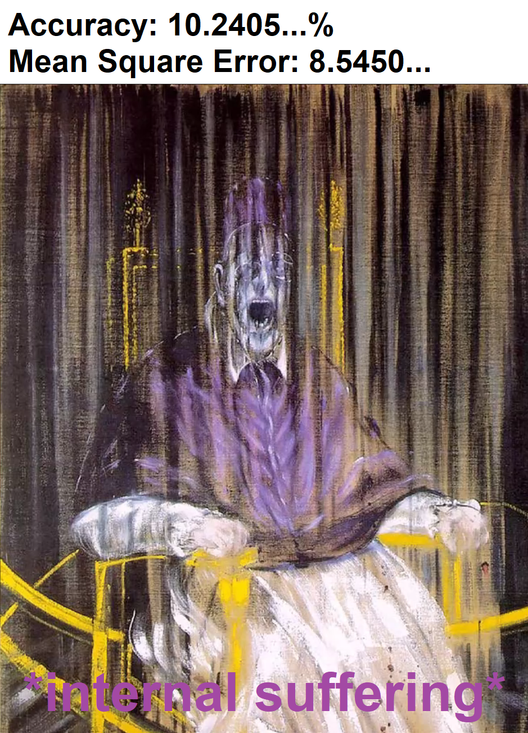
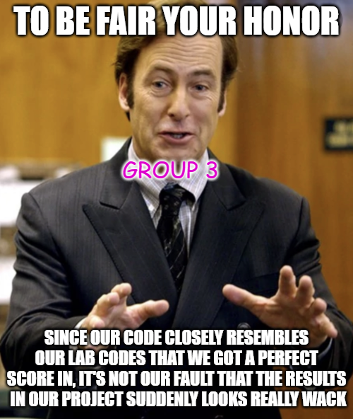


MAYMAYS
Don’t mind him
Our celebration dances after finishing our phenomenal project
Bob and André when glancing upon our marvelous code

